Slide 1


Jahid Hasan
Assistant Professor,Dept. of IPE,SUST
Notes:
Production Planning

Slide 2

Production planning is a process used by manufacturing companies to optimize the efficiency of their processes.
Production Planning
Notes:
Production Planning

Slide 3

Effectively utilize limited resources in the production of goods so as to satisfy customer demands and create a profit for investors.
Resources include the production facilities, labor and materials.
Constraints include the availability of resources, delivery times for the products, and management policies.
Production Planning

Slide 4
Following are the objectives of production planning and control:
1. Systematic planning of production activities to achieve the highest efficiency in production
of goods/services.
2. To organize the production facilities like machines, men, etc., to achieve stated production objectives with respect to quantity and quality time and cost.
3. Optimum scheduling of resources.
4. Coordinate with other departments relating to production to achieve regular balanced and uninterrupted production flow.
5. To conform to delivery commitments.
6. Materials planning and control.
7. To be able to make adjustments due to changes in demand and rush orders.
Production Planning

Slide 5
Forecasting
Aggregate planning
Materials Requirement Planning
  Inventory Management
Sequencing and Scheduling
Production Planning

Slide 6

Objective: predict demand for planning purposes.
Laws of Forecasting:
  1. Forecasts are always wrong!
  2. Forecasts always change!
  3. The further into the future, the less reliable the forecast will be!
Production Planning

Slide 7

Objective: generate a long-term production plan that establishes a rough product mix, anticipates bottlenecks, and is consistent with capacity and workforce plans.
Production Planning

Slide 8
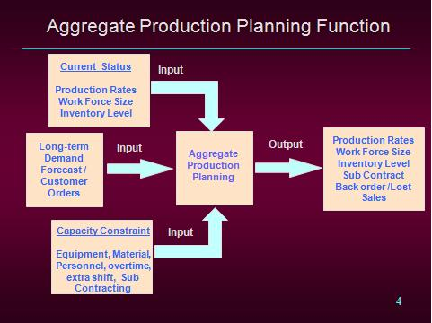

Production Planning

Slide 9

Objective: Determine all purchase and production components needed to satisfy the aggregate/disaggregate plan.
Issues:
  Bill of Materials: Determines components, quantities and lead times.
  Inventory Management: Must be coordinated with inventory.
Production Planning

Slide 10

Objective: develop a plan to guide the release of work into the system and coordination with needed resources (e.g., machines, staffing, materials).
Methods:
  Sequencing:
    Gives order of releases but not times.
  Scheduling:
    Gives detailed release times.
Production Planning

Slide 11

Capacity planning or capacity requirements planning is the function of establishing, measuring and adjusting limits or levels of capacity.
Production Planning

Slide 12
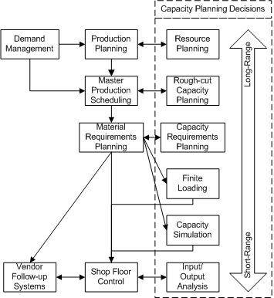
The Capacity Planning Decision Hierarchy
Production Planning

Slide 13

A production plan is the portion of your intermediate-range business plan that your manufacturing operations department is responsible for developing.
Production Planning

Slide 14

Firms need to have a production planning strategy to ensure that there is sufficient capacity to meet the demand forecast and to determine the best plan to meet this demand.
Production Planning

Slide 15

Minimize costs/maximize profits
Maximize customer service
Minimize inventory investment
Production Planning

Slide 16

Minimize changes in production rates
Minimize changes in work-force levels
Maximize the utilization of plant and equipment
Production Planning

Slide 17
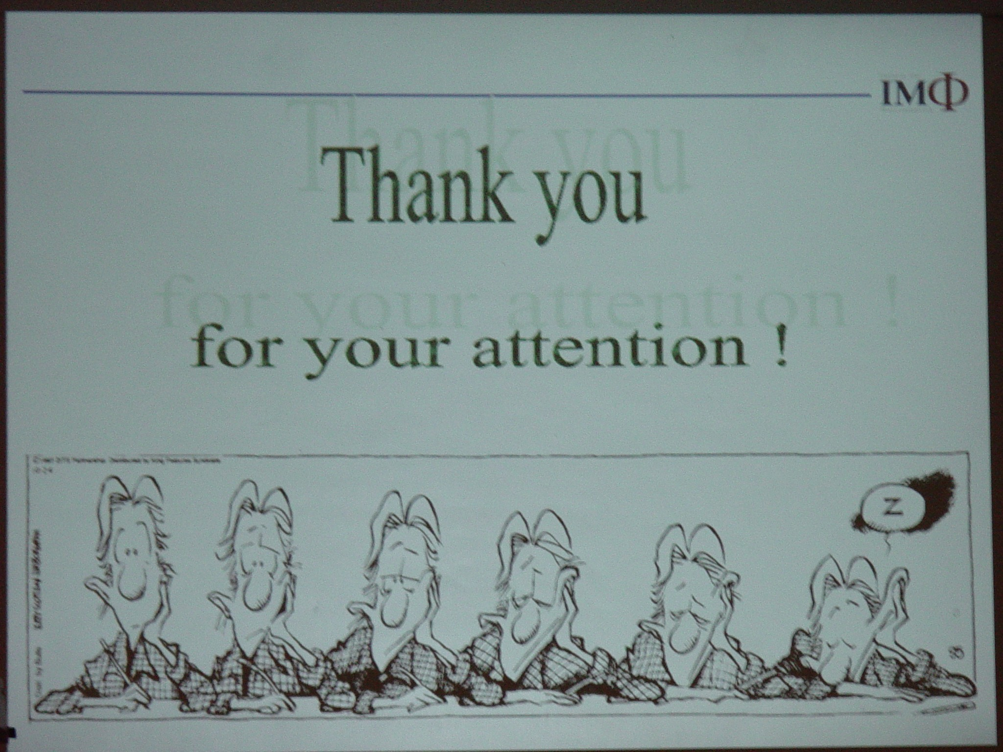
Production Planning

